Slide 1
Late Nineteenth Century – Twentieth Century Science Fiction
Appreciation of English and American Literature
H.G. Wells – The Time Machine
Ray Bradbury – There Will Come Soft Rains

Slide 2
H.G. Wells
The Time Machine (1895)

Slide 3
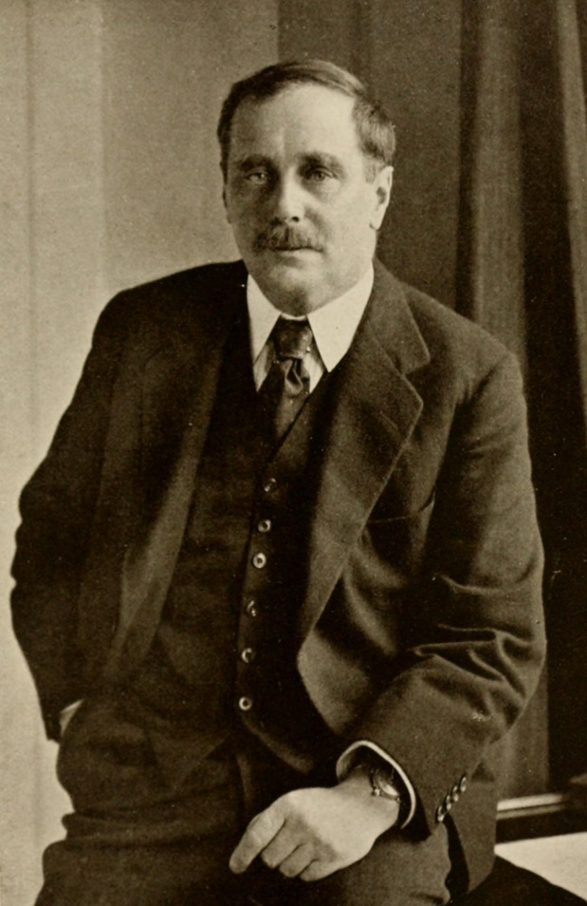
H.G. Wells
Lived 1866-1946. (Herbert George Wells.)
One of the founders of science-fiction. He also wrote The War of the Worlds (1897)
He followed Darwinism, and was a proponent of some Eugenics thinking:
"The way of nature has always been to slay the hindmost, and there is still no other way, unless we can prevent those who would become the hindmost being born. It is in the sterilization of failures, and not in the selection of successes for breeding, that the possibility of an improvement of the human stock lies."

Slide 4
The Fin de Siècle and Degeneration
At the end of the nineteenth century, there was a feeling in Europe that everything was coming to an end…
In France it was called the fin de siècle (end of the century). Some people felt that art, morality, and even humans were starting to collapse.

Slide 5
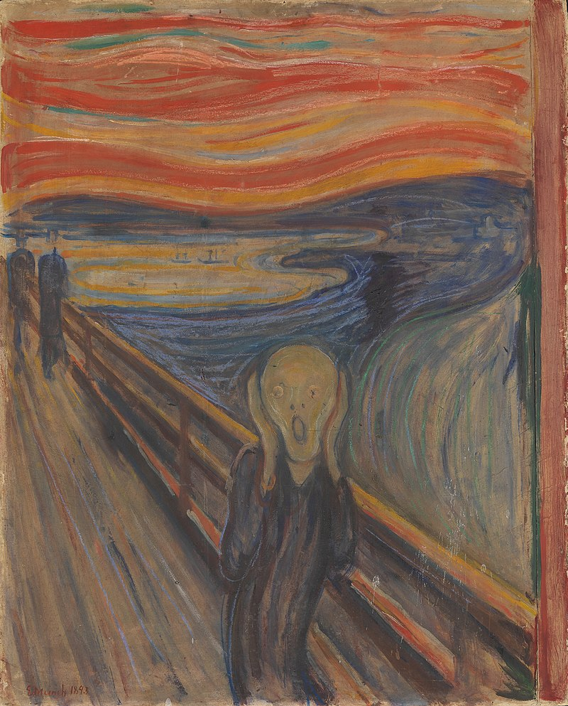
The Fin de Siècle and Degeneration
“I was walking along the road with two friends – the sun was setting – suddenly the sky turned blood red – I paused, feeling exhausted, and leaned on the fence – there was blood and tongues of fire above the blue-black fjord and the city – my friends walked on, and I stood there trembling with anxiety – and I sensed an infinite scream passing through nature.”
The Scream, by Edvard Munch (1893)

Slide 6
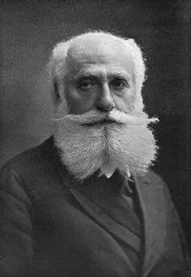
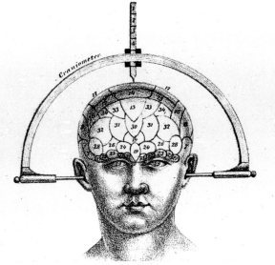
The Fin de Siècle and Degeneration
In 1892 Max Nordau wrote a book called Degeneration, in which he said that humans were degrading into less developed forms, and that many writers and artists were examples of these people:
… “all these fin-de-siècle cases have, nevertheless, a common feature, to wit, a contempt for traditional views of custom and morality … This means unbridled lewdness, the unchaining of the beast in man; to the withered heart of the egoist, disdain of all consideration for his fellow-men, the trampling under foot of all barriers which enclose brutal greed of lucre and lust of pleasure; to the contemner of the world it means the shameless ascendency of base impulses and motives.”

Slide 7
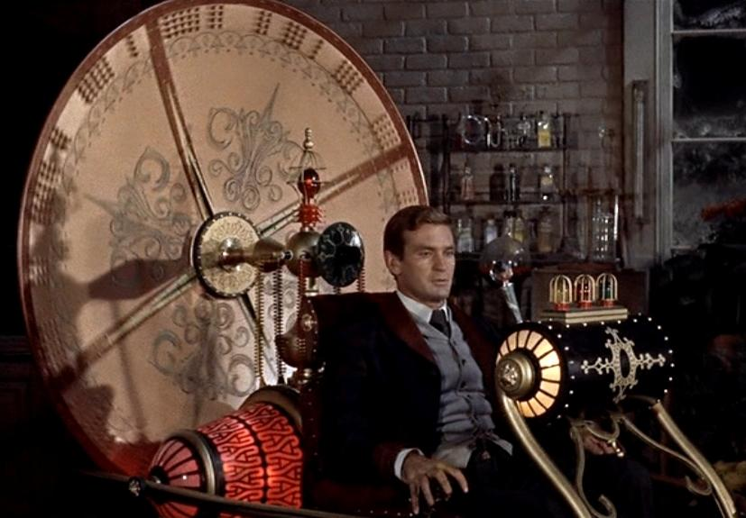
The Time Machine
How does the story open?
What does the Time Traveller discover?
How does H.G. Wells use English?
The novel uses a ‘frame story’ – a common technique in the 19th century: the narrator tells us the story that the time traveller told him.

Slide 8
The Time Machine
What does the story reveal about H.G. Wells, and his views about people and society?
What does it suggest about the fears and debates of his era?

Slide 9
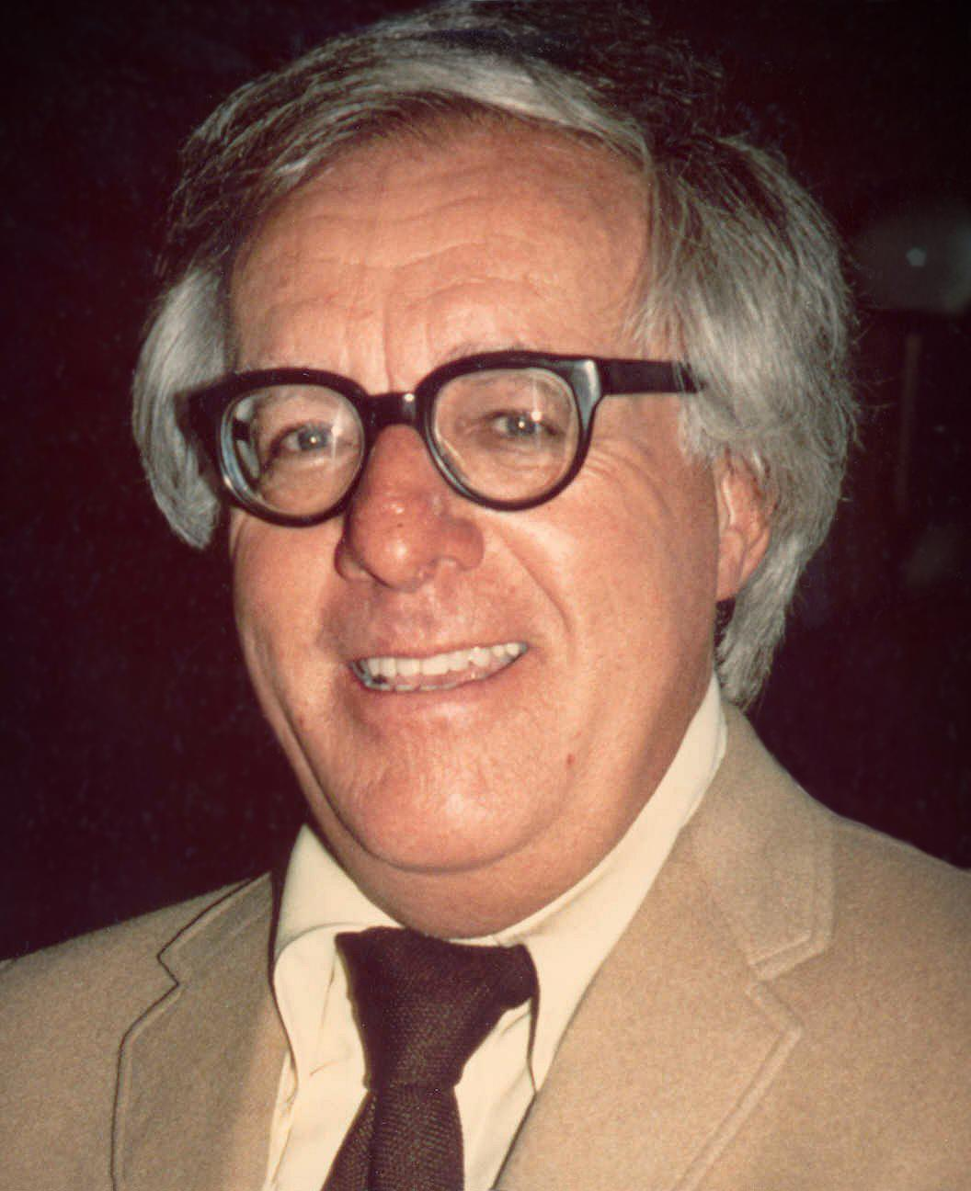
Ray Bradbury
Lived 1920-2012.
An American writer, born in Illinois, but lived largely in Los Angeles.
He wrote short stories on a range of science-fiction, fantasy, and horror topics, and is most well-known for the novel Fahrenheit 451 in 1953.
There Will Come Soft Rains (1950) is a post-apocalyptic short story. It was published in a magazine, and the book of stories, The Martian Chronicles.

Slide 10
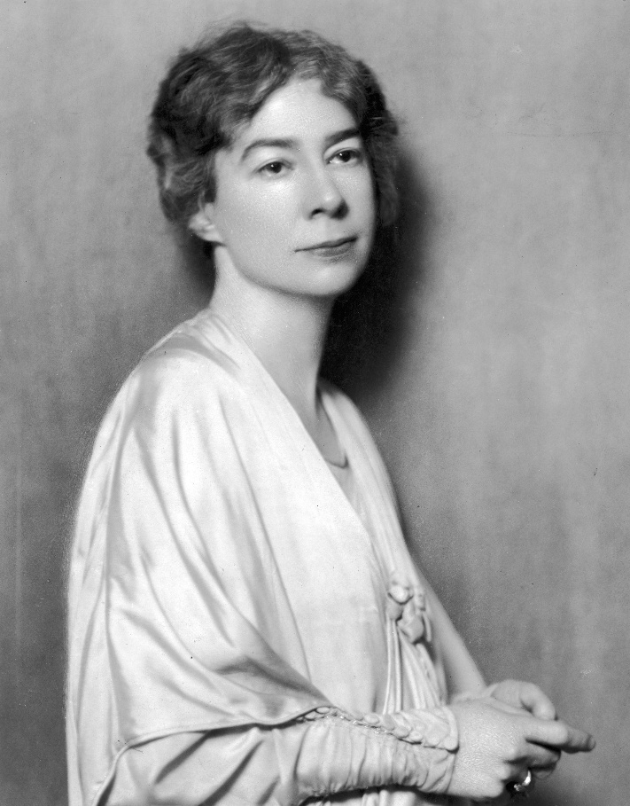
Sara Teasdale (1884-1933)
The title of Bradbury’s short story is from a poem by Sara Teasdale, written in 1918, during World War I and after the Spanish Flu pandemic began.
She lived 1884-1933. She died by suicide.
She was an American ‘lyric poet’ – a personal style that often uses a formal metre.

Slide 11
Sara Teasdale (1884-1933)
What is the poem about?
How is it composed – metre, rhyme, techniques?
The poem is written in tetrameter, but an irregular one (four feet – usually 4 stresses – but varying syllables), and rhyming couplets.

Slide 12
Ray Bradbury – There Will Come Soft Rains
What happens in the story?
What relevance does the poem have to the story?
What is Bradbury’s style like? How is his use of English different to H. G. Wells’ style?
- Find an interesting example to show your classmates.

Slide 13
Ray Bradbury – There Will Come Soft Rains
What can we learn about Bradbury’s view of his own era and the future?
How accurate are Wells and Bradbury with their science-fiction?

Slide 14
Writing Practice
1. Write a couple of academic paragraphs to explain how 19th century cultural debates shaped literature.
2. Analyse a recent literary/film science-fiction story in terms of current cultural concerns.
3. Write a short story about the future, which reflects the fears of present culture. (You could include a framing device.)

Slide 15
Homework reading
Read the short excerpts of modernist texts:
Virginia Wolfe’s, To the Lighthouse
Scott, F. Fitzgerald’s, The Great Gatsby
James Joyce’s Dubliners
Consider the style of English and the presentation of characters and reality.

